Slide 1
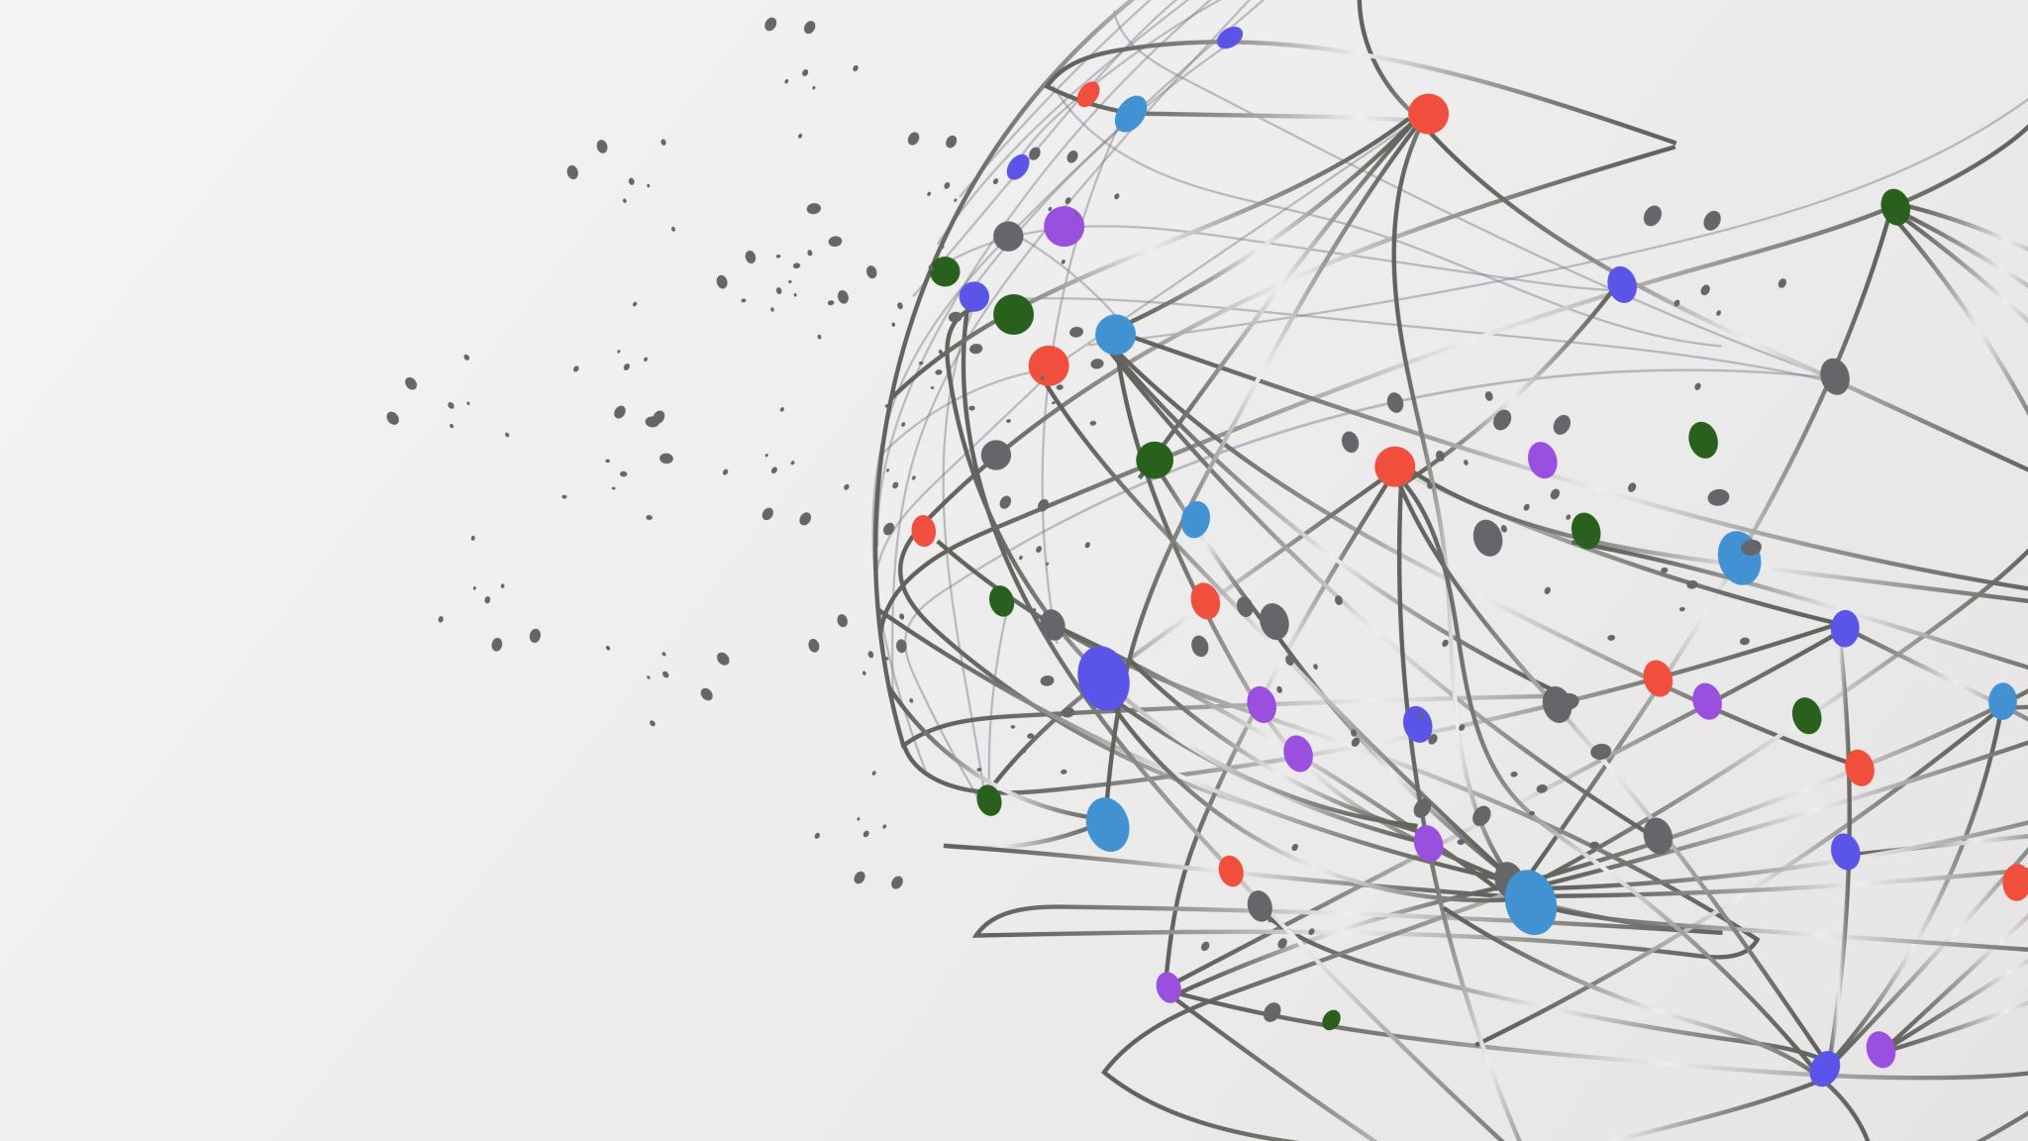
Ascii Art
Kane, Cory, Trent, Trevor, Kyle

Slide 2

Current Advancements
Graphics
GUI concepts and designs
Started on back-end development
Prioritizing the importance of order of development

Slide 3
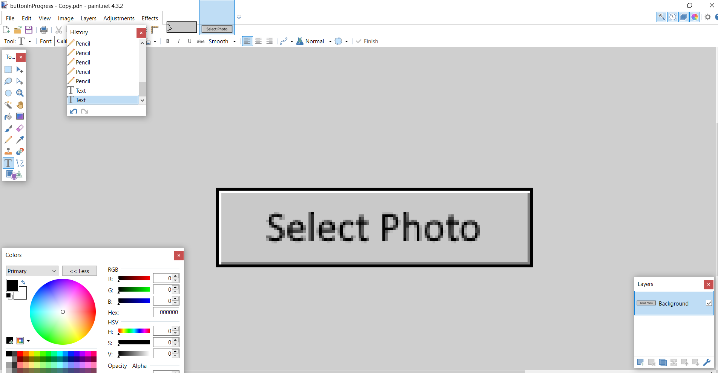
Graphics

Slide 4
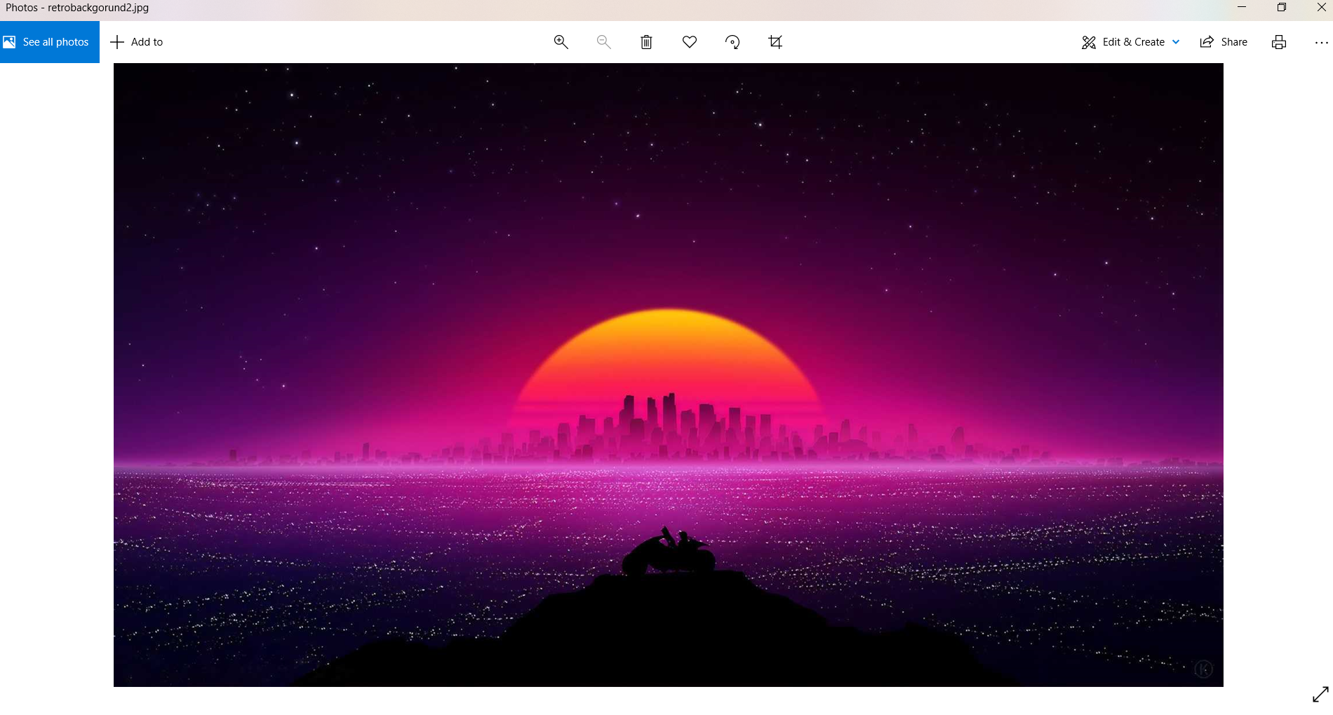
Graphics Pt. 2

Slide 5
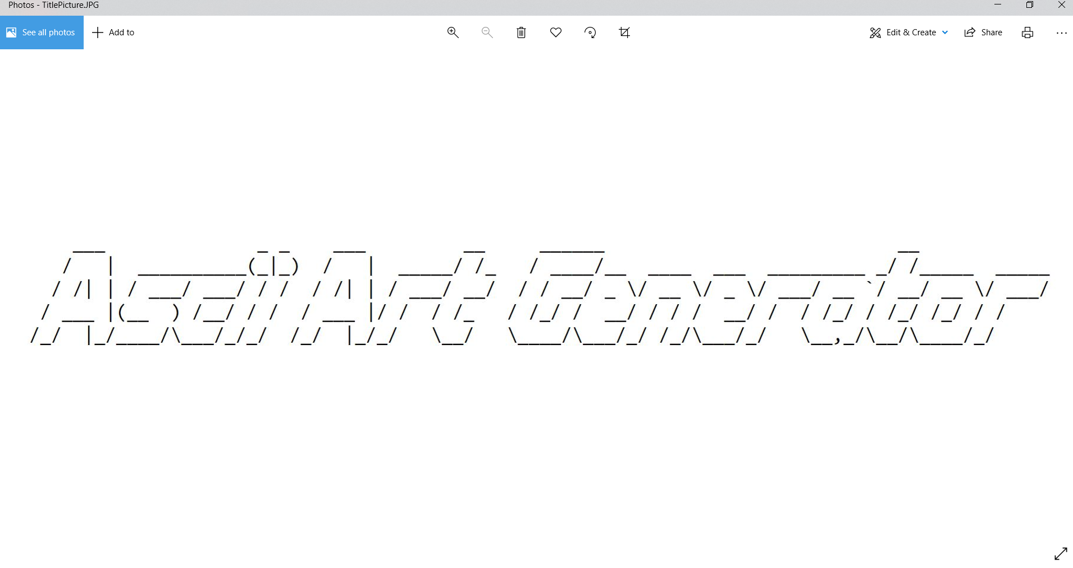
Graphics Pt. 3

Slide 6
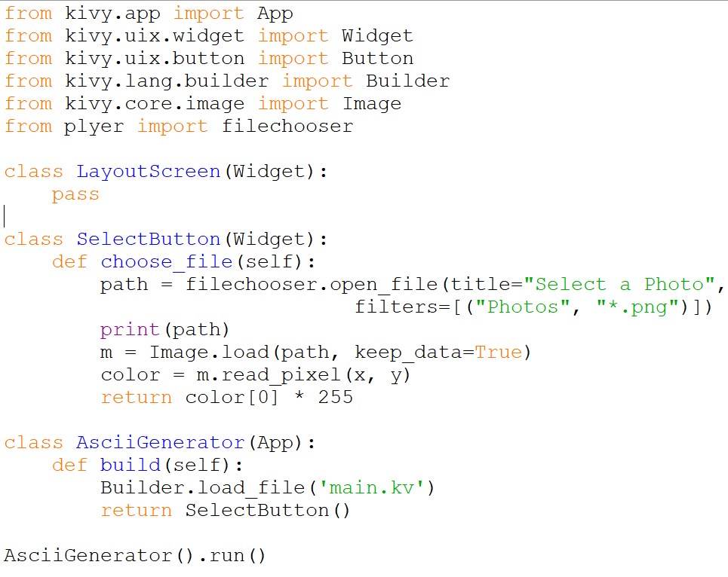
Back-End

Slide 7
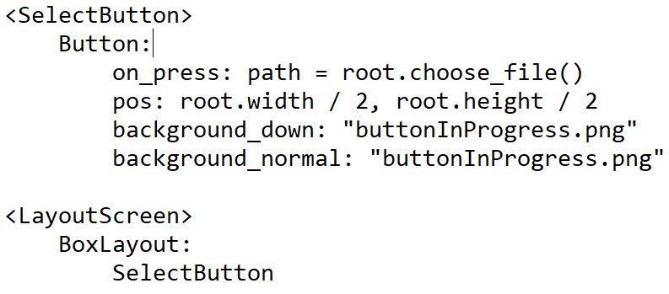
Back-End

Slide 8
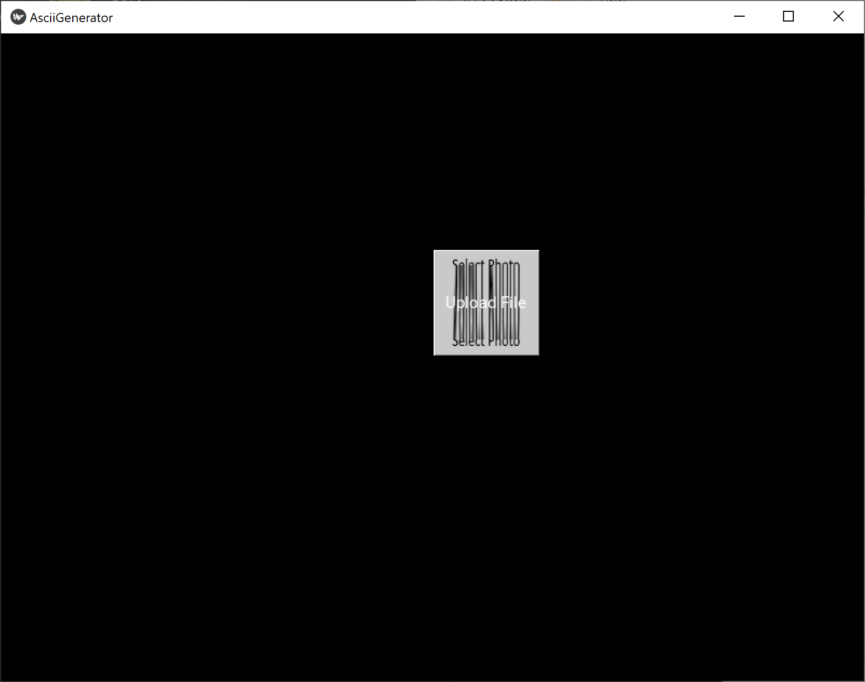
Back-End

Slide 9
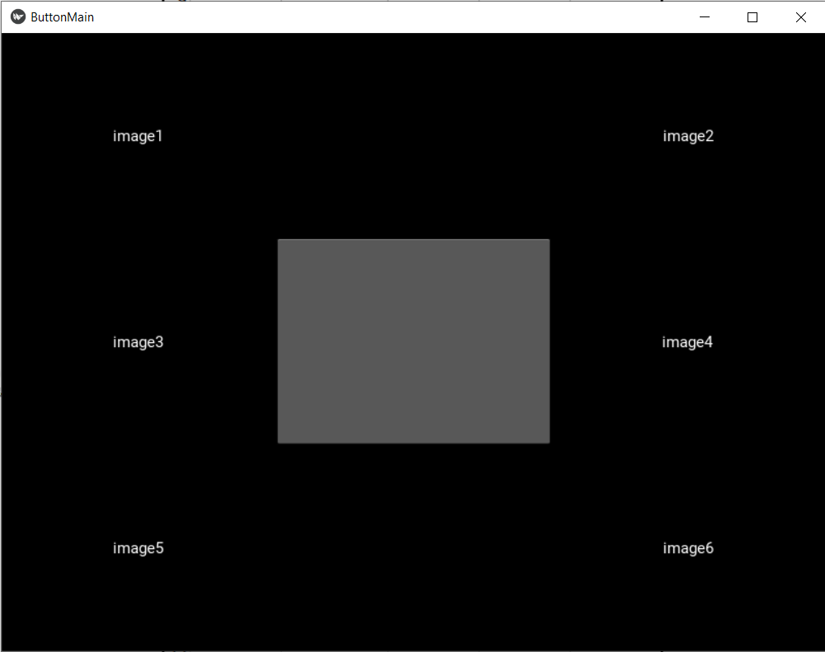
Prototype GUI

Slide 10

Kivy Installation
Everyone has been trying to get up to date with Kivy and learn the framework
Some difficulties in download process

Slide 11

Roadblocks
Kivy complications
Learning Python
Button scaling issues

Slide 12
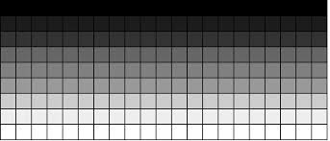
Future and Upcoming Plans
Coding algorithm to convert pixels into Ascii characters based on grey scale
Fix kivy problems
Fix scaling issues
Find good starting resolution to convert and calculate how many pixels to bundle together

